Slide 1

Unlocking Insights: Customer Segmentation Using E- Commerce Data

Slide 2

Introduction to Customer Segmentation
In today's digital age, customer segmentation is essential for businesses to tailor their strategies effectively.
By analyzing e-commerce data, companies can identify distinct customer groups and understand their preferences.
This presentation will explore segmentation strategies that unlock valuable insights and drive better marketing decisions.

Slide 3

Importance of Customer Segmentation
Recognizing the significance of customer segmentation enables businesses to improve customer experiences.
Identifying various customer needs and behaviors helps companies design tailored marketing campaigns, boost customer retention, and drive sales.
Leveraging effective segmentation strategies is crucial for driving business growth.
Objective
Divide customers into distinct groups or clusters, enabling companies to tailor their products, services, and marketing efforts accordingly.

Slide 4

Leveraging E-Commerce Data
E-commerce data provides valuable insights into customer behavior through purchase history, browsing patterns, and feedback.
Analyzing this data allows businesses to segment their audience more effectively.
Leveraging tools such as data analytics and machine learning enhances the understanding of customer patterns, leading to more informed decision-making

Slide 5


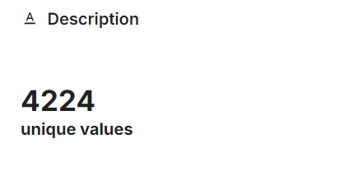
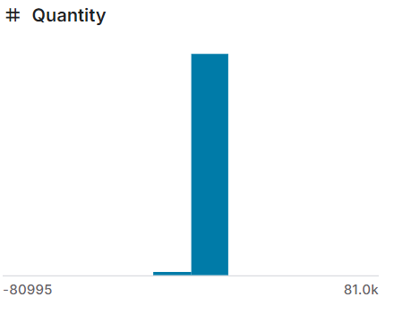
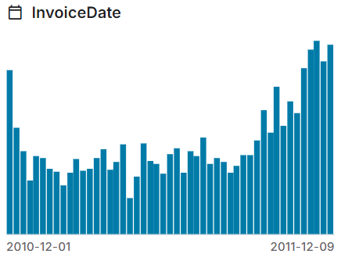
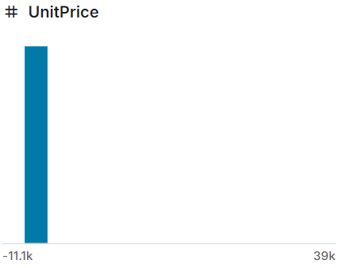
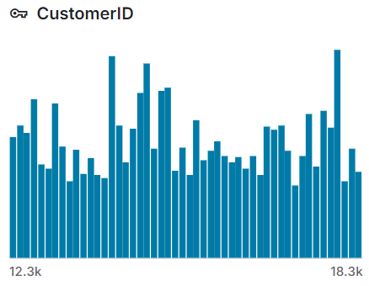
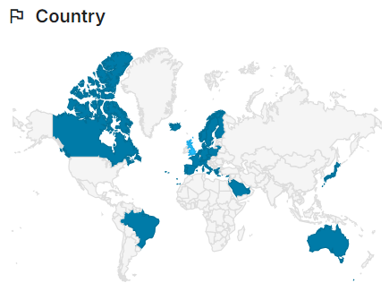
Data Overview

Slide 6

Data Analytics Techniques
Utilizing data analytics techniques such as clustering, regression analysis, and predictive modeling helps businesses uncover valuable insights.
These methods are effective in identifying patterns and trends within customer data.
By revealing these insights, businesses can achieve more precise segmentation and develop targeted strategies that resonate with different customer groups.

Slide 7
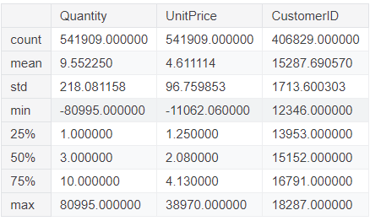
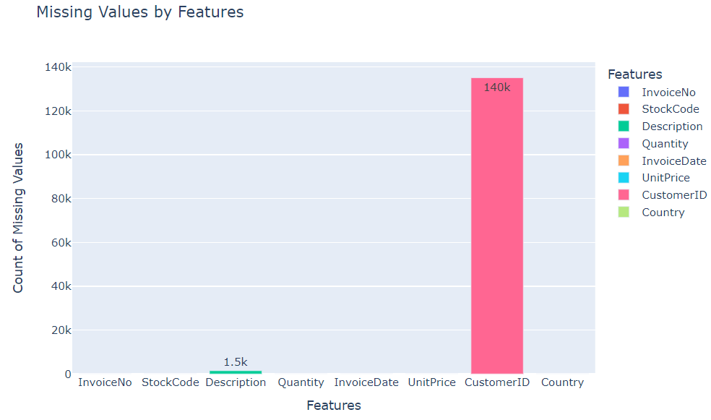
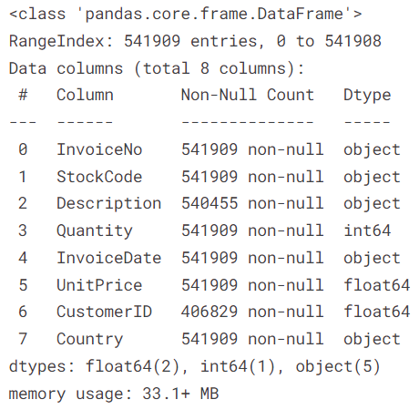
Exploratory Data Analysis
Data Understanding
The dataset, comprising 541,909 rows and 8 columns, contains missing values in certain columns, and the InvoiceDate and CustomerID fields are incorrectly typed, while the Quantity and UnitPrice columns include negative values.
Data Preparation and Cleaning
Identified that approximately 140,000 transactions, or 24.93% of the Customer data, have missing Customer information, and 1,500 items, representing 0.27%, have missing descriptions. Converted the InvoiceDate and CustomerID to the appropraite datatypes

Slide 8
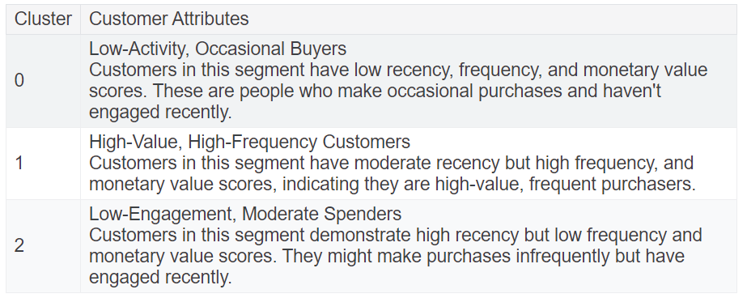
Insights

Slide 9
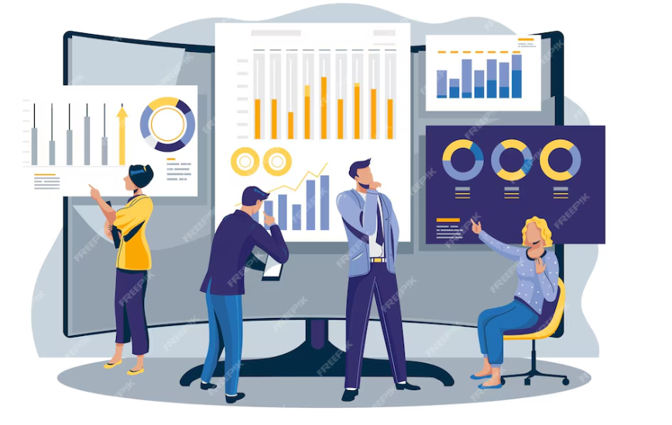
Conclusion
In conclusion, customer segmentation through e-commerce data is essential for creating targeted marketing strategies. By identifying and understanding various customer groups, businesses can boost engagement and increase sales. Ultimately, the effective use of data analytics is the key to unlocking insights that drive sustainable growth.

Slide 10
Thank you!
Jayakar Angalakuduru
jayakarangalakudauru@gmail.com
+919347932845

